Slide 1
Travel Workflow Approvals – Tutorial

Slide 2
Tips and Tricks
Tips and Tricks
Supervisors can use either ESS or SAP to act upon work items
Supervisors can Disapprove, Process Later or Replace the work item at any time
Supervisors can only Approve after first reviewing the Expense Statement and, if required, verifying mileage and receipts
Notes:
2

Slide 3
Tips and Tricks
Tips and Tricks Continued
Supervisors have the ability to attach receipts
Supervisors will receive an email notification that they have expense reports pending review and approval
Notes:
3

Slide 4
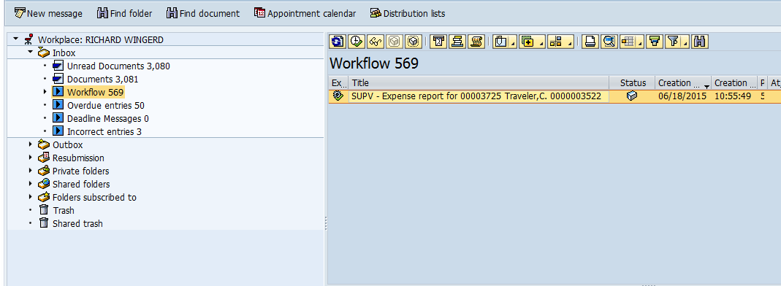
SAP GUI Business Workplace Inbox
Execute icon
This is how the SAP inbox appears. If you are using SAP GUI for approval, select the item and then select the execute icon.
Notes:
4

Slide 5
Travel Workflow Approvals
This is how the ESS Universal Worklist appears. If you are using ESS to complete approvals, select the trip by clicking on the subject text.
Notes:
5

Slide 6
SAP GUI Business Workplace Inbox
This is how the ESS Universal Worklist appears. If you are using ESS to complete approvals, select the trip by double clicking on the subject text.
Notes:
6

Slide 7
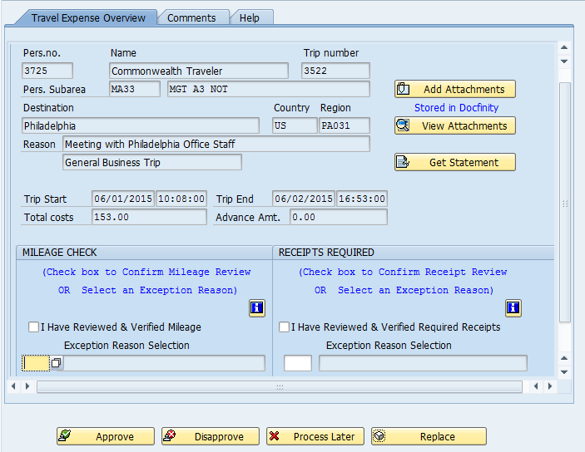
SAP GUI Business Workplace Inbox
The left hand side of the work item contains information for the employee and a high level overview of the expense report.
The right hand side of the work item contains the options for reviewing the expense statement and receipts.
Notes:
7

Slide 8
SAP GUI Business Workplace Inbox
The mileage verification box will only appear if the supervisor is required to verify personal vehicle mileage claimed is in accordance with policy. The supervisor can review the current policy by selecting the information icon.
The receipts verification box will only appear if receipts are required to be attached when submitting the expense report. The supervisor can review the current policy by selecting the information icon.
Policy information icon
Policy information icon
Notes:
8

Slide 9
SAP GUI Business Workplace Inbox
The bottom row of buttons contains the options for working on the workflow.
Notes:
9

Slide 10
SAP GUI Business Workplace Inbox
As part of reviewing the expense reports, supervisors must review the expense statement by selecting “Get Statement”.
Notes:
10

Slide 11
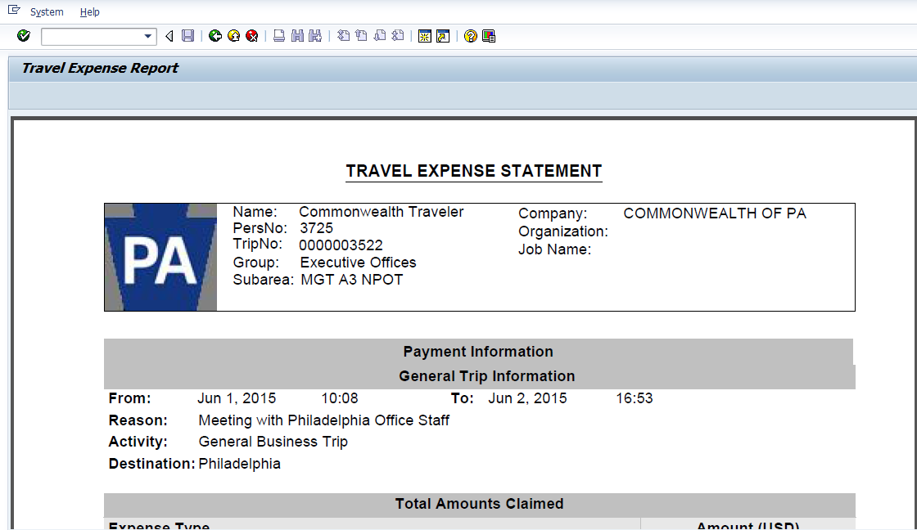
SAP GUI Business Workplace Inbox
After reviewing the statement, use the back button to return to the workitem.
Notes:
11

Slide 12
SAP GUI Business Workplace Inbox
As part of the approval process, supervisors need to review receipts and personal vehicle mileage justification by selecting “View Attachments”
Notes:
12

Slide 13
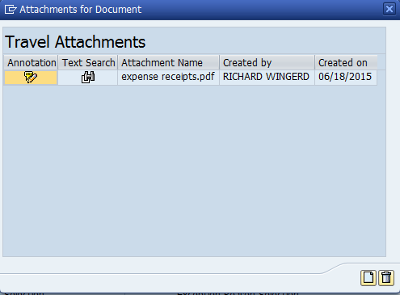
Travel Workflow Approvals
Select the document to be displayed by selecting the icon under the Text Search column. This will open the receipt in a new window.
Notes:
13

Slide 14
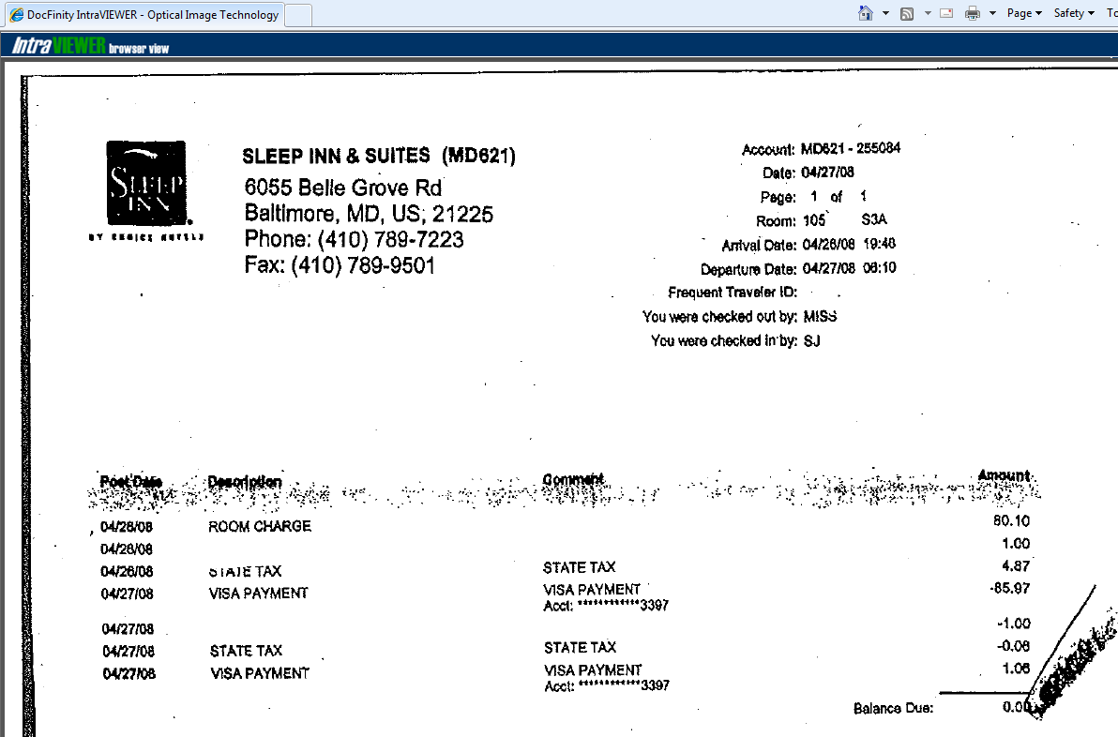
Travel Workflow Approvals
Notes:
14

Slide 15
SAP GUI Business Workplace Inbox
If receipts are required, the supervisor needs to confirm they have reviewed the receipts. If you have confirmed all of the required receipts are attached, select “I Have Reviewed & Verified Receipts”
If receipts are required, but not attached and there is an approved BCPO exception, select an exception reason by using the drop down menu.
Notes:
15

Slide 16
SAP GUI Business Workplace Inbox
If personal vehicle mileage justification is required, the supervisor needs to confirm they have reviewed the justification. If you have confirmed the required justification is attached, select “I Have Reviewed & Verified Mileage”
If mileage justification is required, but not attached and there is an approved BCPO exception, select the exception reason by using the drop down menu.
Notes:
16

Slide 17
SAP GUI Business Workplace Inbox
After reviewing the Expense Statement and selecting an option in the Receipt Required and Mileage Check sections, the approval button becomes active and you can approve the trip.
Notes:
17

Slide 18
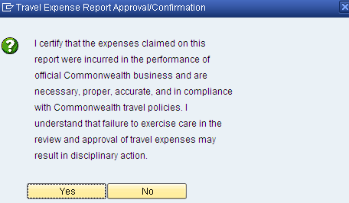
Travel Workflow Approvals
Select “Yes” to approve and certify expenses claimed were incurred in accordance with Commonwealth policy.
Notes:
18

Slide 19
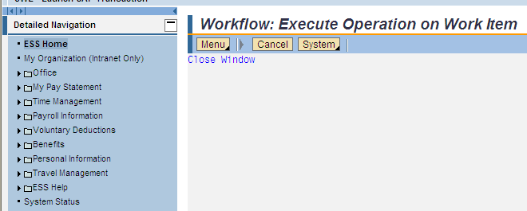
Travel Workflow Approvals
Work item has been successfully acted upon. If you have further ESS transactions to complete, return to the ESS home menu by selecting “ESS Home” on the left hand menu bar. If not, exit ESS by selecting “Log Off”.
Notes:
19

Slide 20
Additional Resources
Need help?
Contact the Travel Expense Help Desk:
1-800-824-0626 outside the Harrisburg area
717-346-3401 within the Harrisburg area
Co-travelaudits@pa.gov
Notes:
20

