Slide 1
Approve A Travel Expense Adjustment Request

Slide 2
Tips and Tricks
Tips and Tricks
Supervisors can use either ESS or SAP to act upon work items
If using ESS, the only browser supported is Internet Explorer
Supervisors can Disapprove, Process Later or Replace the work item at any time
Notes:
2

Slide 3
Tips and Tricks
Tips and Tricks Continued
Supervisors have the ability to attach receipts
Supervisors will receive an email notification that they have adjustment requests pending review and approval
Notes:
3

Slide 4
Approve a Travel Expense Adjustment Request
Notes:
4

Slide 5
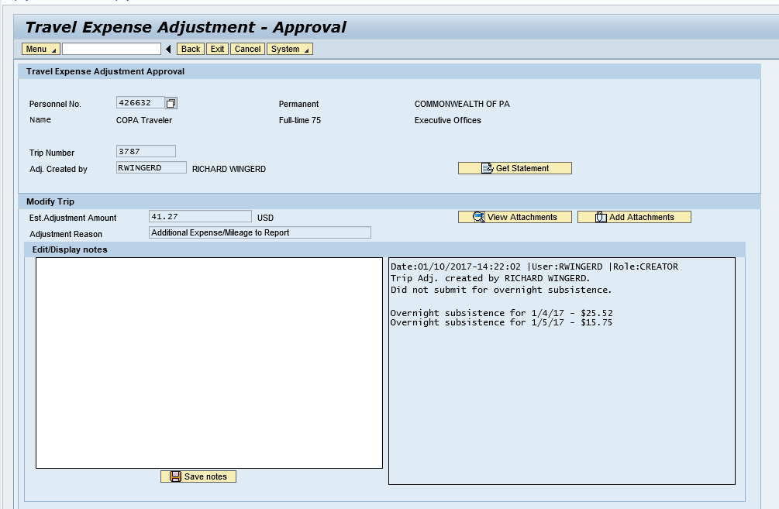
Approve a Travel Expense Adjustment Request
When selected, the work item will appear. The top section will contain the traveler, trip information and who submitted the adjustment request.
Notes:
5

Slide 6
Approve a Travel Expense Adjustment Request
The bottom section will contain the requested adjustment amount, the reason for the adjustment and the details of the adjustment.
Notes:
6

Slide 7
Approve a Travel Expense Adjustment Request
A note field will also be available for the supervisor to add additional notes.
Notes:
7

Slide 8
Approve a Travel Expense Adjustment Request
View the existing expense statement by selecting Get Statement.
Notes:
8

Slide 9
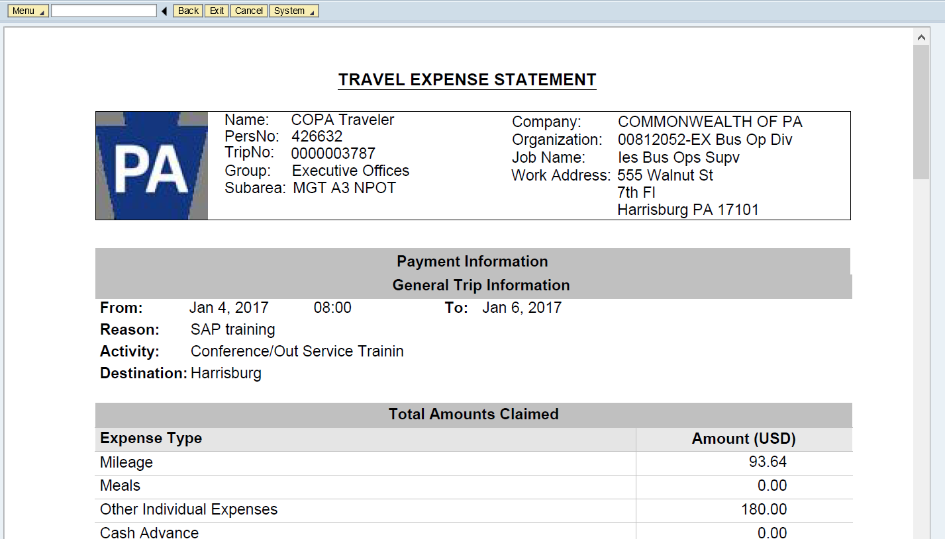
ESS Submit a Travel Expense Adjustment Request
After reviewing the existing statement, return to the adjustment form by selecting the “back” key.
Notes:
9

Slide 10
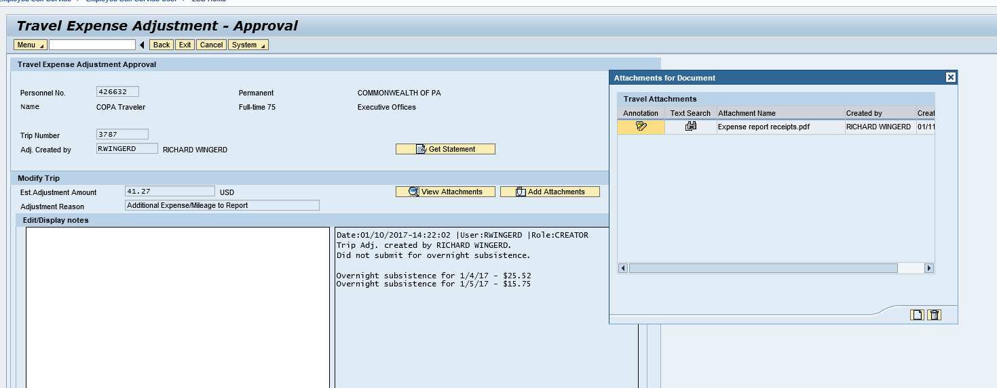
Approve a Travel Expense Adjustment Request
View the existing attachments by selecting View Attachments.
Notes:
10

Slide 11
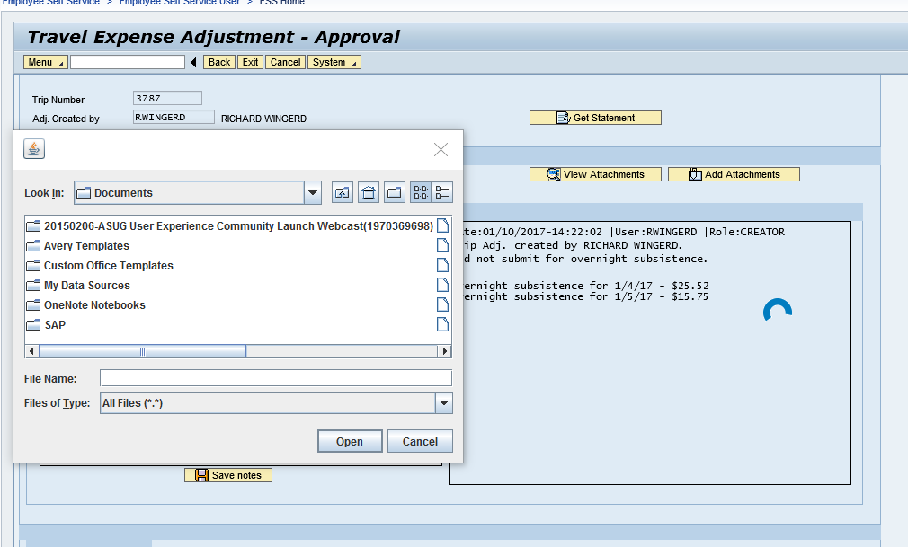
Approve a Travel Expense Adjustment Request
Supervisors can also add additional attachments by selecting Add Attachments
Notes:
11

Slide 12
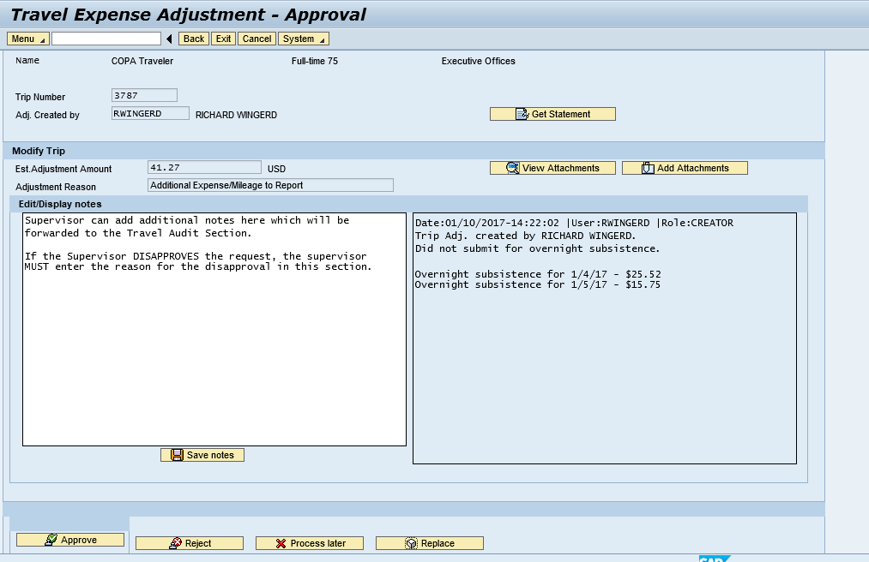
Approve a Travel Expense Adjustment Request
After reviewing the adjustment request, the supervisor can add additional notes which will be forwarded to the Travel Audit Section. If the supervisor is Disapproving the request, the Supervisor MUST enter the reason for the disapproval in this section. All comments entered by the supervisor will be stored in the workflow log.
Notes:
12

Slide 13
Approve a Travel Expense Adjustment Request
After reviewing and determining the adjustment is correct and valid, the supervisor can approve the adjustment by selecting Approve. This will send the work item to the Travel Audit Section for final review and approval.
Notes:
13

Slide 14
Approve a Travel Expense Adjustment Request
Once the work item has been acted upon, the work item will close and the supervisor can use the menu options on the left hand menu bar to return to their inbox or exit ESS.
If the supervisor is using the GUI to approve, the supervisor will be returned to the inbox.
Notes:
14

Slide 15
Additional Resources
Need help?
Contact the Travel Expense Help Desk:
1-800-824-0626 outside the Harrisburg area
717-346-3401 within the Harrisburg area
Co-travelaudits@pa.gov
Notes:
15
WBT slide #
Answer: 1. True
Correct! Expense types are entered as receipts for reimbursement.

