Slide 1

Employee Self Service – Create a Travel Expense Report tutorial

Slide 2
Tips and Tricks
Tips and Tricks
Time format is based upon a 24 hour clock(military format).
Do not use your browser buttons to navigate while in the travel request, use the ESS navigation buttons.
You may need to use the scroll bars to navigate in order to access all options.
When selecting the services, they will open in a new window.
Notes:
2

Slide 3
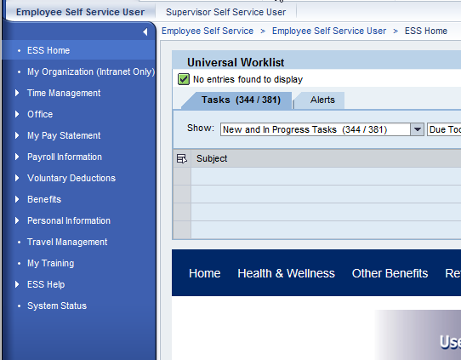
Create a Travel Expense Report
From the navigation menu, select “Travel Management”.

Slide 4
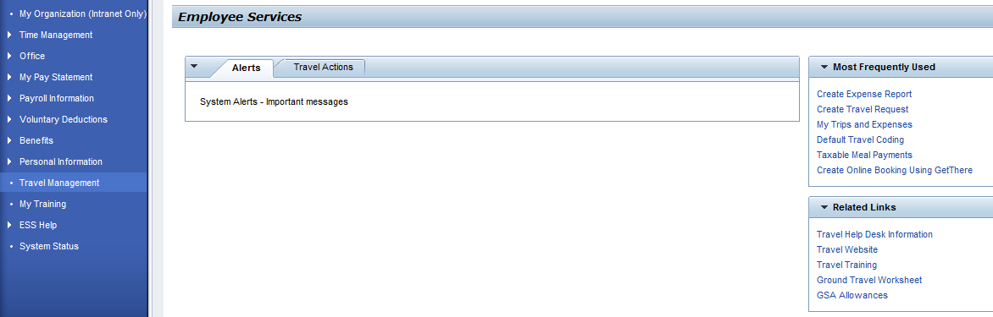
Create a Travel Expense Report
This tutorial will go through an example on how to create an expense report using the link “Create Expense Report”
Select “Travel Actions”.
If “Create Expense Report” is listed in the Most Frequently Used section, the request can be started by selecting it here.

Slide 5
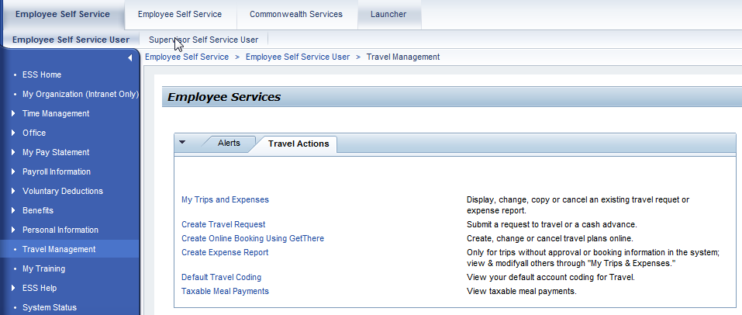
Completing a Travel Request
Select “Create Expense Report”. This will open a new browser window with the Create Expense Report transaction.
.

Slide 6
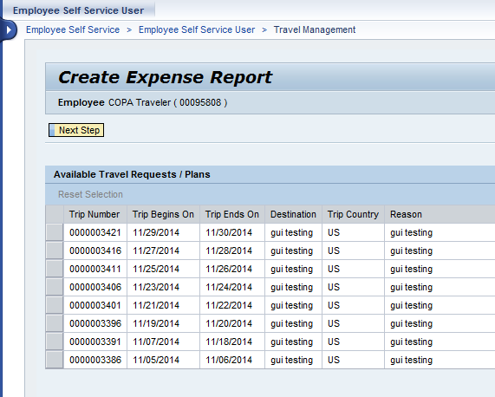
Create a Travel Expense Report
If you are not creating an expense report from an existing travel request/plan, select “Next Step” and this will create a new trip.
If you are creating an expense report for an existing travel request/plan, select the trip, then select “Next Step”
Notes:
6

Slide 7
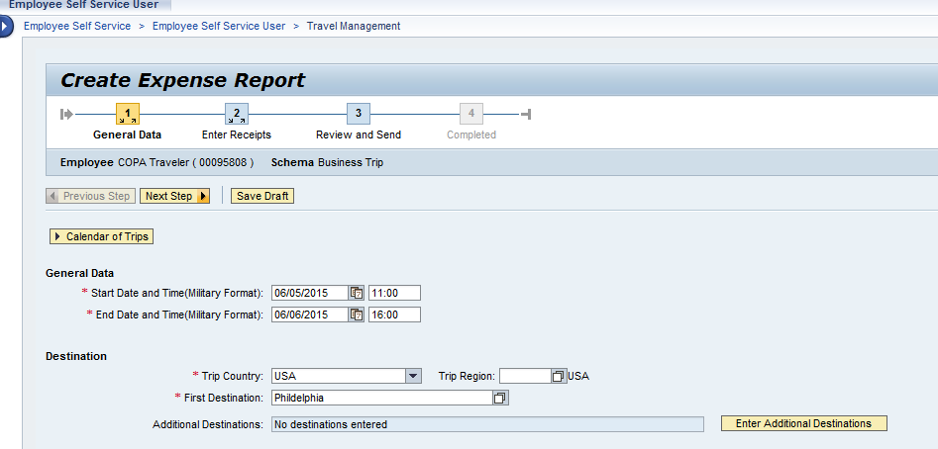
Create a Travel Expense Report
Notice all of the information contained in the travel request/plan is pre-populated into the expense report.
Review the pre-populated information and make changes as needed.
Required fields are marked with a red asterisk *
Notes:
7

Slide 8
Create a Travel Expense Report
If your trip is to a high cost area, use the Trip Region to select the high cost region.
Notes:
8

Slide 9
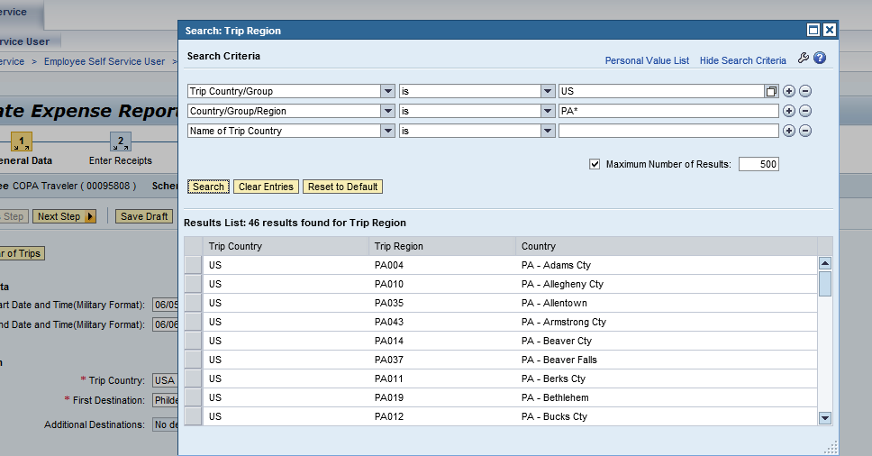
Create a Travel Expense Report
Select “Show Search Criteria” to search for and find the correct region code. Search by state by using the 2 digit postal code for the state followed by *. For example, PA* for Pennsylvania, then select “Search”.
Notes:
9

Slide 10
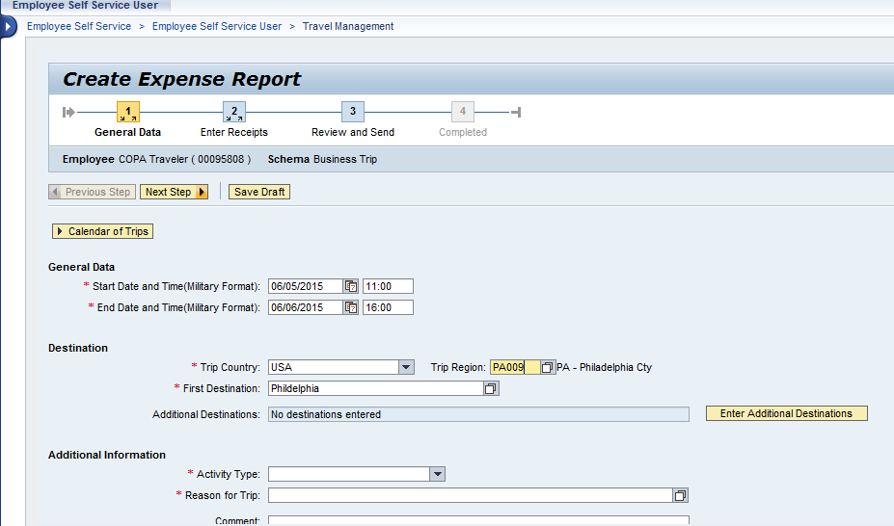
Create a Travel Expense Report
Note: All required fields need to be completed before entering additional destinations.
If your trip contains multiple destinations, select “Enter Additional Destinations” to open a screen to enter these destinations.
Notes:
10

Slide 11
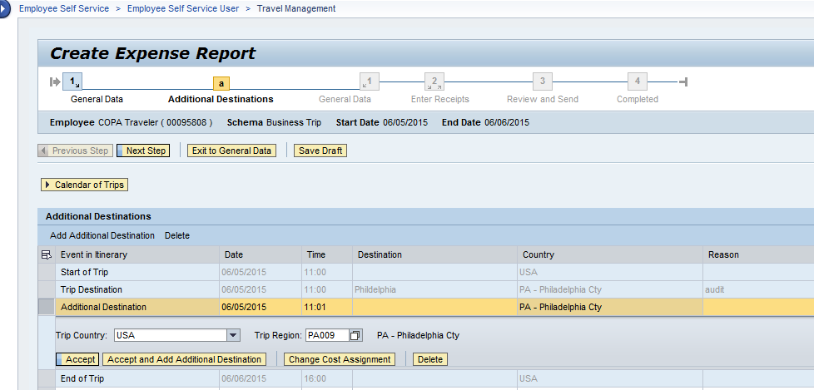
Create a Travel Expense Report
Enter the date, location and region (if high cost) for each of the additional destinations.
When completed, select “Accept” to continue.
Notes:
11

Slide 12
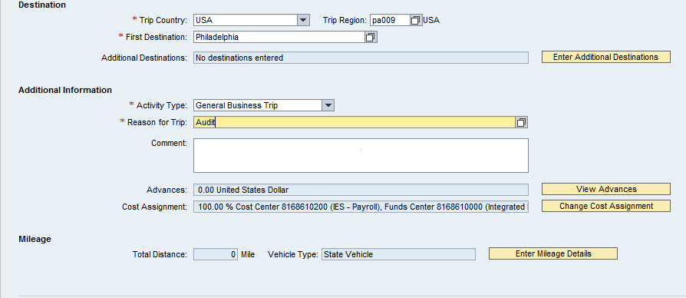
Create a Travel Expense Report
When needed, use the Comment box to provide supporting justification for the expenses you are claiming.
If you need to change the coding on your entire trip, select “Change Cost Assignment”. If you have questions on the correct account coding to be used, please see your supervisor or contact your fiscal office.
Notes:
12

Slide 13
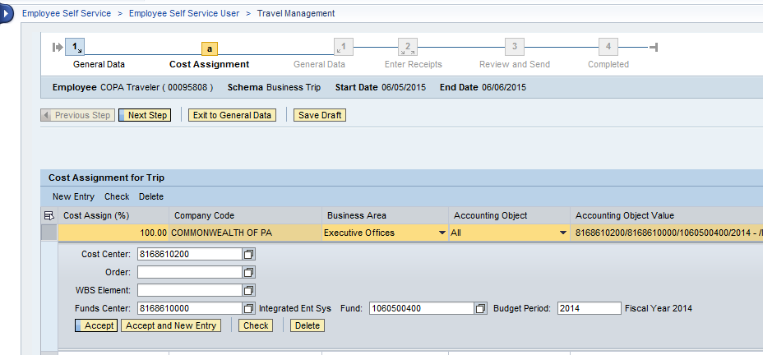
Create a Travel Expense Report
Enter the new account coding. If you have more than one account code, select “New Entry”.
When completed, select “Accept” to continue.
Notes:
13

Slide 14
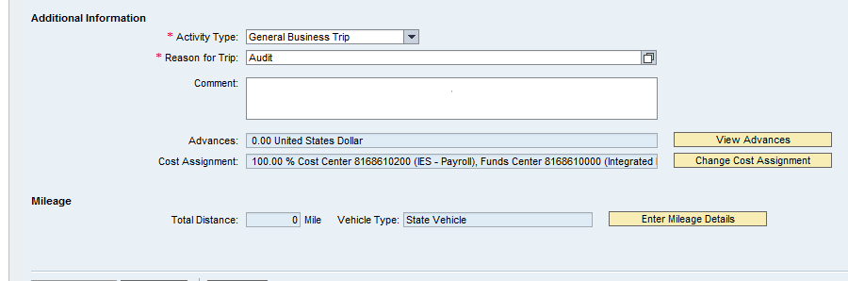
Create a Travel Expense Report
To enter vehicle mileage, select “Enter Mileage Details” to enter the number of miles driven by day using either a state vehicle or your personal vehicle.
All mileage must be broken down by segment. Lump sum entries are not permitted.
Notes:
14

Slide 15
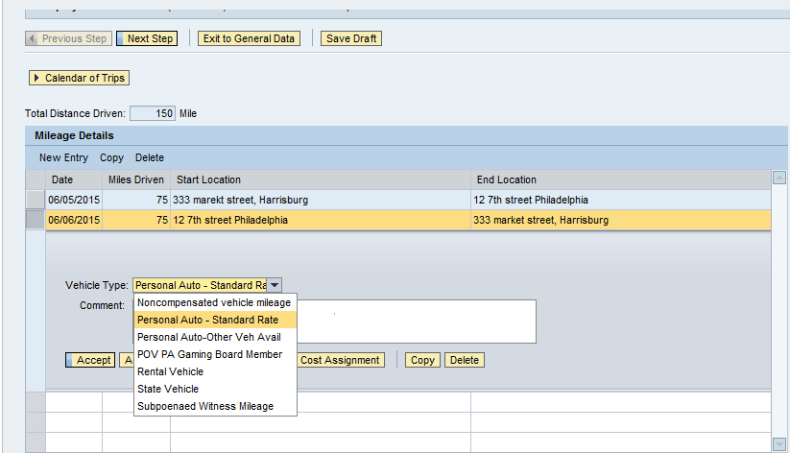
Create a Travel Expense Report
Enter the date, number of miles, starting and ending locations and select the type of vehicle. To enter more segments, select “Accept and New Entry.”
“Start" and “End" locations must be recorded and must be specific enough for a reviewer and/or auditor to substantiate the reported mileage.
Vehicle Types
Notes:
15

Slide 16
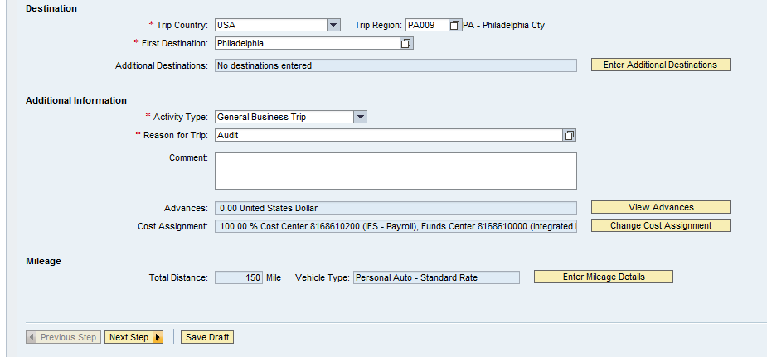
Create a Travel Expense Report
When you are ready to enter your expense, select “Next Step”
Notes:
16

Slide 17
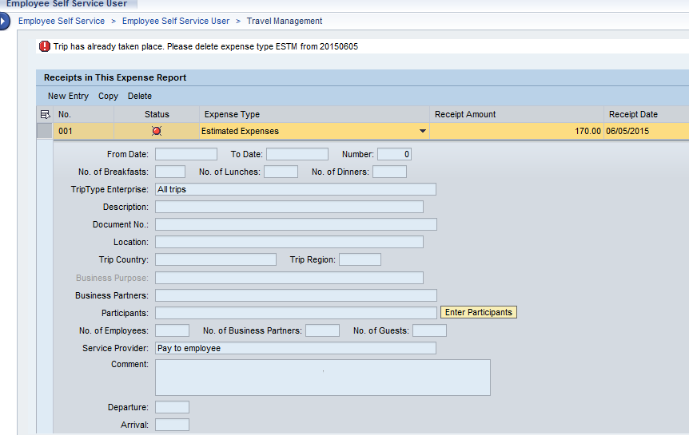
Create a Travel Expense Report
Any items from the travel request/plan will be pre-populated. If “Estimated Expenses” is listed, you will need to delete the item.
Notes:
17

Slide 18
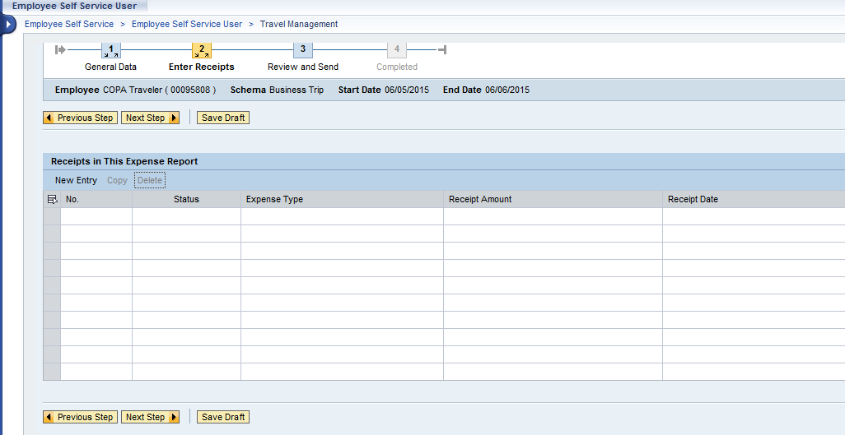
Create a Travel Expense Report
Select “New Entry” to begin.
Notes:
18

Slide 19
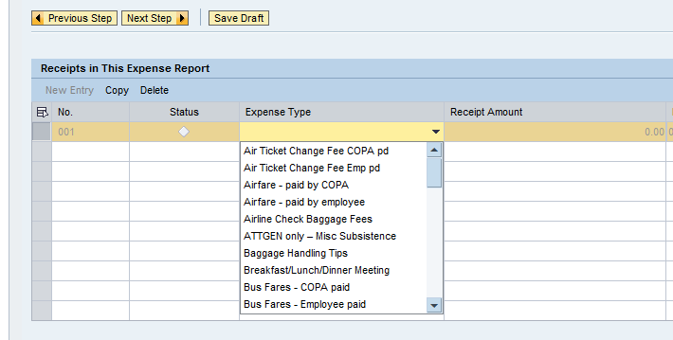
Create a Travel Expense Report
Now you are ready to enter your expenses. Use the drop down menu to select the expense type to enter.
Notes:
19

Slide 20
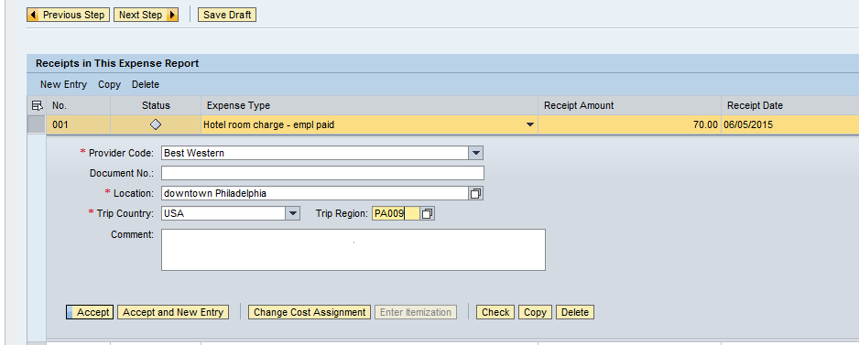
Create a Travel Expense Report
Once you have selected the expense type, enter the amount, date and any other required field. When needed, use the Comment box to provide supporting justification for the expense you are claiming.
Notes:
20

Slide 21
Create a Travel Expense Report
If you need to change the coding for a particular expense, select “Change Cost Assignment”
Notes:
21

Slide 22
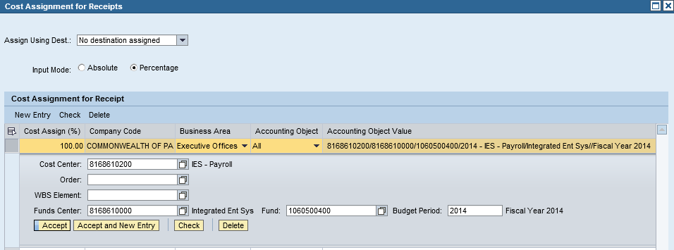
Create a Travel Expense Report
After entering all of the account code changes, select “Accept”
Enter the account code. If you have more than one account code, select “Accept and New Entry”.
Notes:
22

Slide 23
Create a Travel Expense Report
If you are entering the same expense type multiple times, select “Copy”. This will make a copy of what you just entered, then change the date and amount claimed as needed.
Notes:
23

Slide 24
Create a Travel Expense Report
When you are ready to select another expense, select “Accept and New Entry”
Notes:
24

Slide 25
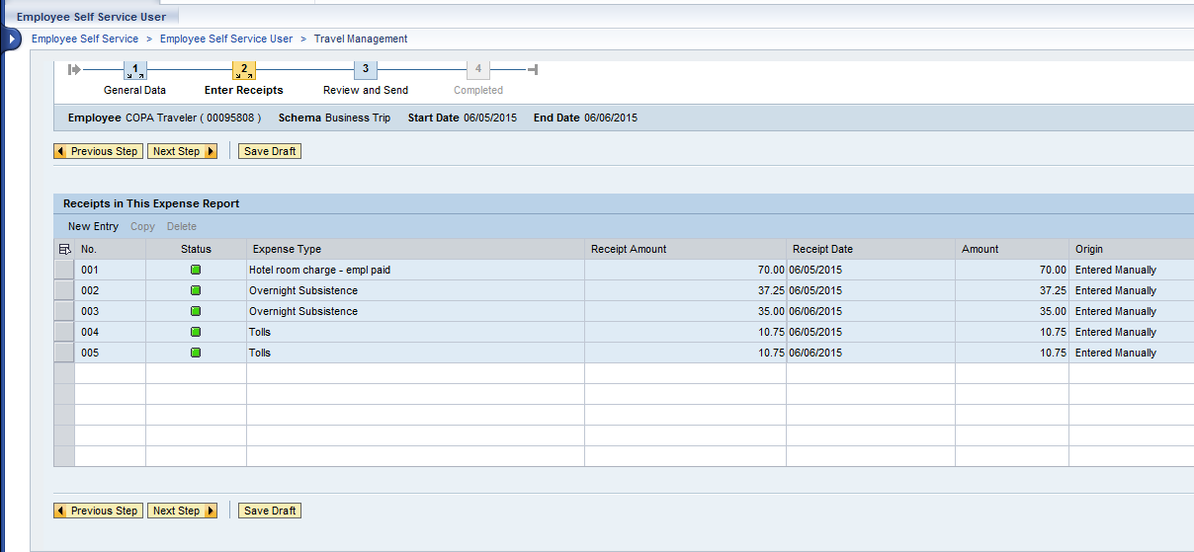
Create a Travel Expense Report
When you are done entering expense types, select “Next Step” to continue.
Notes:
25

Slide 26
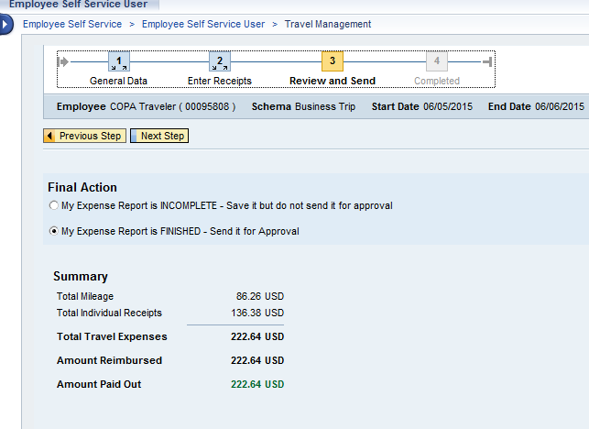
Create a Travel Expense Report
The Summary page will be displayed. This will summarize the total expenses being claimed, the amount being paid by COPA, any advances and what is being paid to the employee.
Notes:
26

Slide 27
Create a Travel Expense Report
You will then have two options.
My Expense Report is INCOMPLETE – This will save the expense report but will not submit it to your supervisor for approval.
My Expense Report is FINISHED – This will save the expense report and will submit it to your supervisor for approval.
Notes:
27

Slide 28
Create a Travel Expense Report
For this example, the traveler is submitting to their supervisor for approval. After selecting the “Final Action” select “Next Step”
Notes:
28

Slide 29
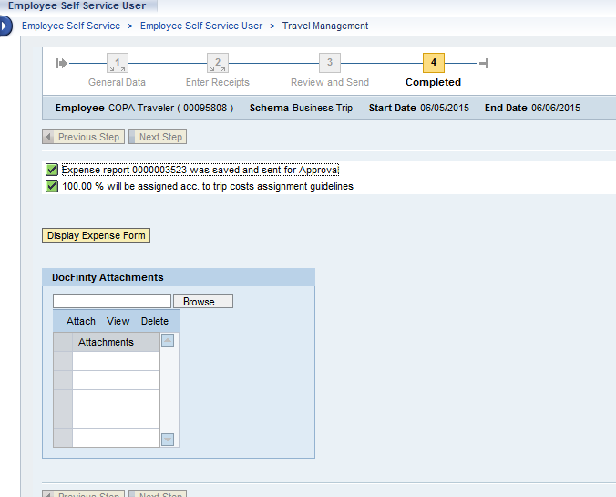
Create a Travel Expense Report
After the trip is saved, the trip number will be displayed.
You can view the statement by selecting “Display Expense Form”
Note: This statement will be displayed in a new window.
Notes:
29

Slide 30
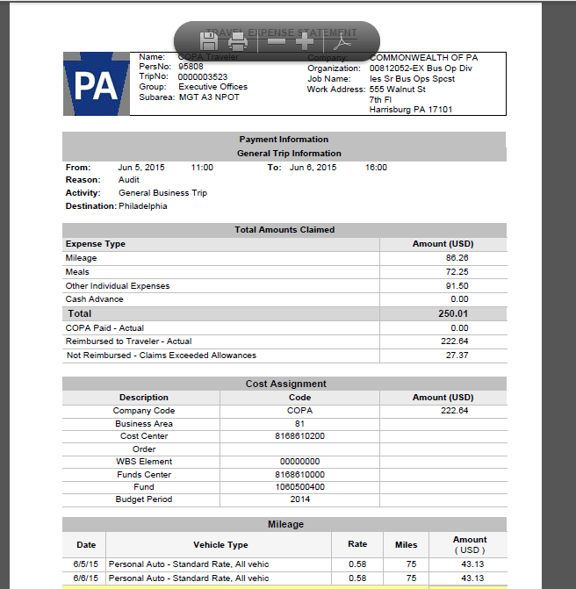
Create a Travel Expense Report
To print, right click on the statement and then select print from the menu or select the print icon at the top of the statement.
The Travel Expense Statement will be displayed in a separate window in an Adobe format.
Notes:
30

Slide 31
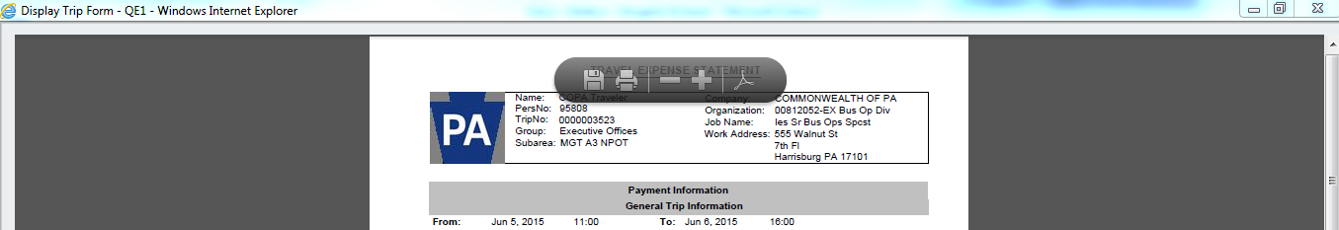
Create a Travel Expense Report
After reviewing the travel expense statement, close the window by selecting the “X” in the top right hand corner of the window.
Notes:
31

Slide 32
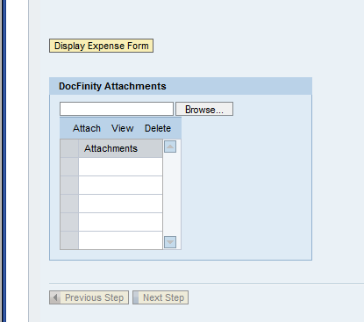
Create a Travel Expense Report
You are now ready to attach scanned copies of your receipts using the attachment functionality.
Select “Browse” to find the file(s) containing your receipts.
Notes:
32

Slide 33
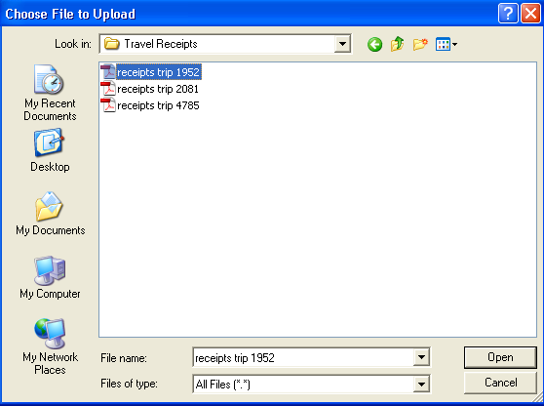
Create a Travel Expense Report
A box will appear for you to select the file from your computer or network drive. Once you find the file, select the file and then select “OPEN”
Notes:
33

Slide 34
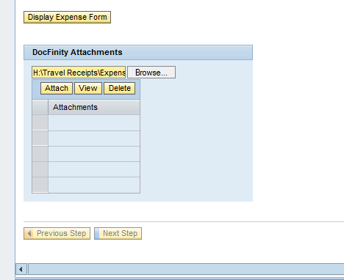
Create a Travel Expense Report
Select “Attach”
Notes:
34

Slide 35
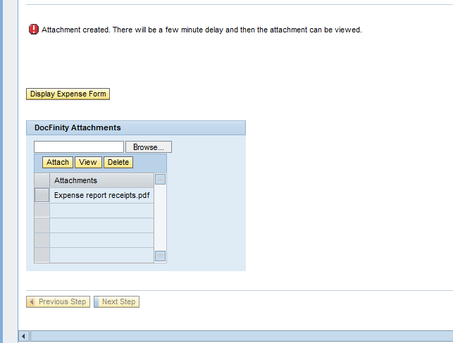
Create a Travel Expense Report
A confirmation message will appear.
NOTE: There will be a few minutes delay before you will be able to view the attachment.
The file you selected is now listed as an Attachment.
Notes:
35

Slide 36
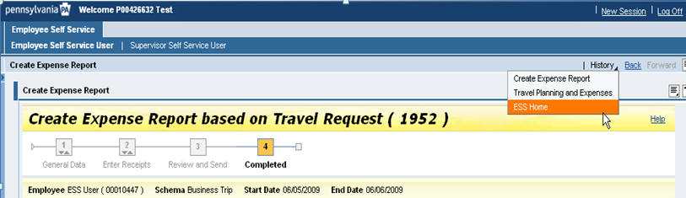
Create a Travel Expense Report
If you do NOT have any additional ESS tasks, you can log out of ESS by selecting Log Off.
If you do have additional ESS tasks, use the History option. If you have additional Travel tasks, select “Travel Planning and Expenses”, if other ESS tasks, such as leave request, select “ESS Home”.
Notes:
36

Slide 37
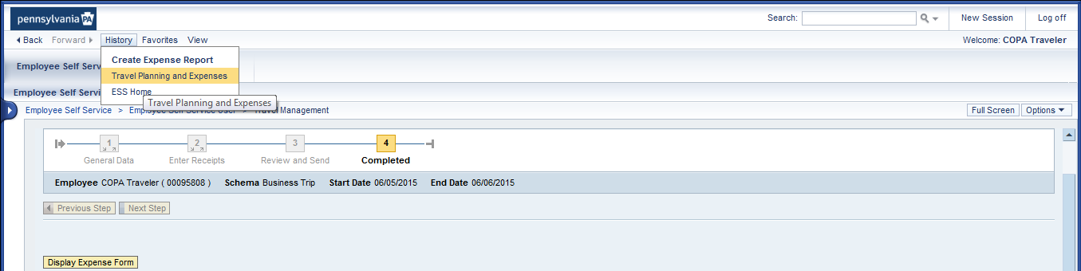
Create a Travel Expense Report
If you do NOT have any additional ESS tasks, you can log out of ESS by selecting Log Off.
If you do have additional ESS tasks, use the History option. If you have additional Travel tasks, select “Travel Planning and Expenses”, if other ESS tasks, such as leave request, select “ESS Home”.
Notes:
37

Slide 38
Create a Travel Expense Report
Need to correct an expense report after it has been paid?
Call the BCPO Travel Expense Help Desk for assistance.

Slide 39
Additional Resources
Need help?
Contact the Travel Expense Help Desk:
1-800-824-0626 outside the Harrisburg area
717-346-3401 within the Harrisburg area
Co-travelaudits@pa.gov
Notes:
39

